Slide 1
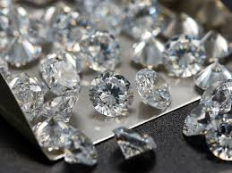
Insight Report of Cubic Zirconia Gem Stone AnalysiS

Slide 2
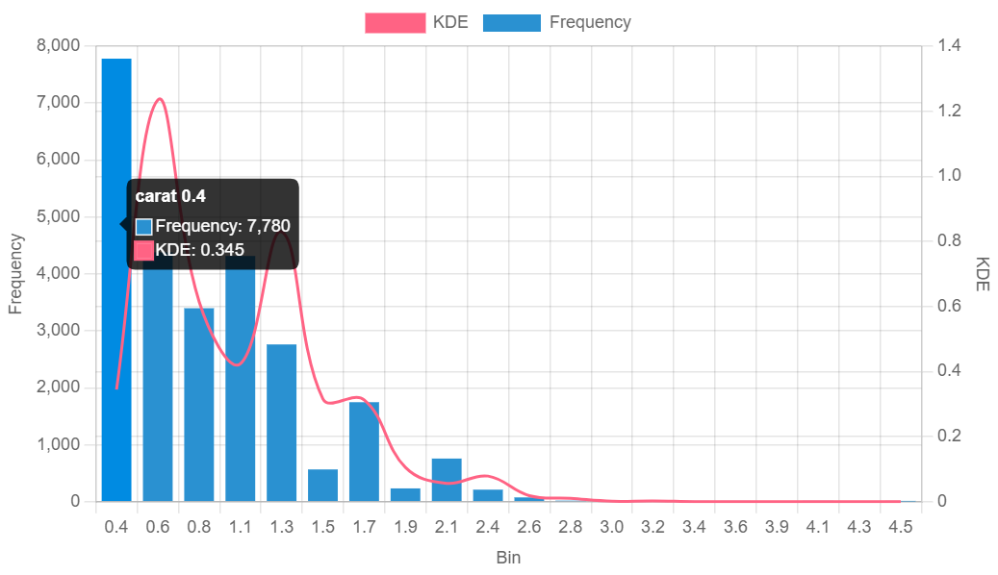
Analysis on Carat characterstic of gem stone The carat of cubic zerconi manufactured here ranges from 0.2 to 4.5 in which the more manufactured gemstone's carat is between 0.4 to 1.05 and we also have some 75 exceptional gemstones which are manufactured at carat ranging between 2 to 4.5.

Slide 3
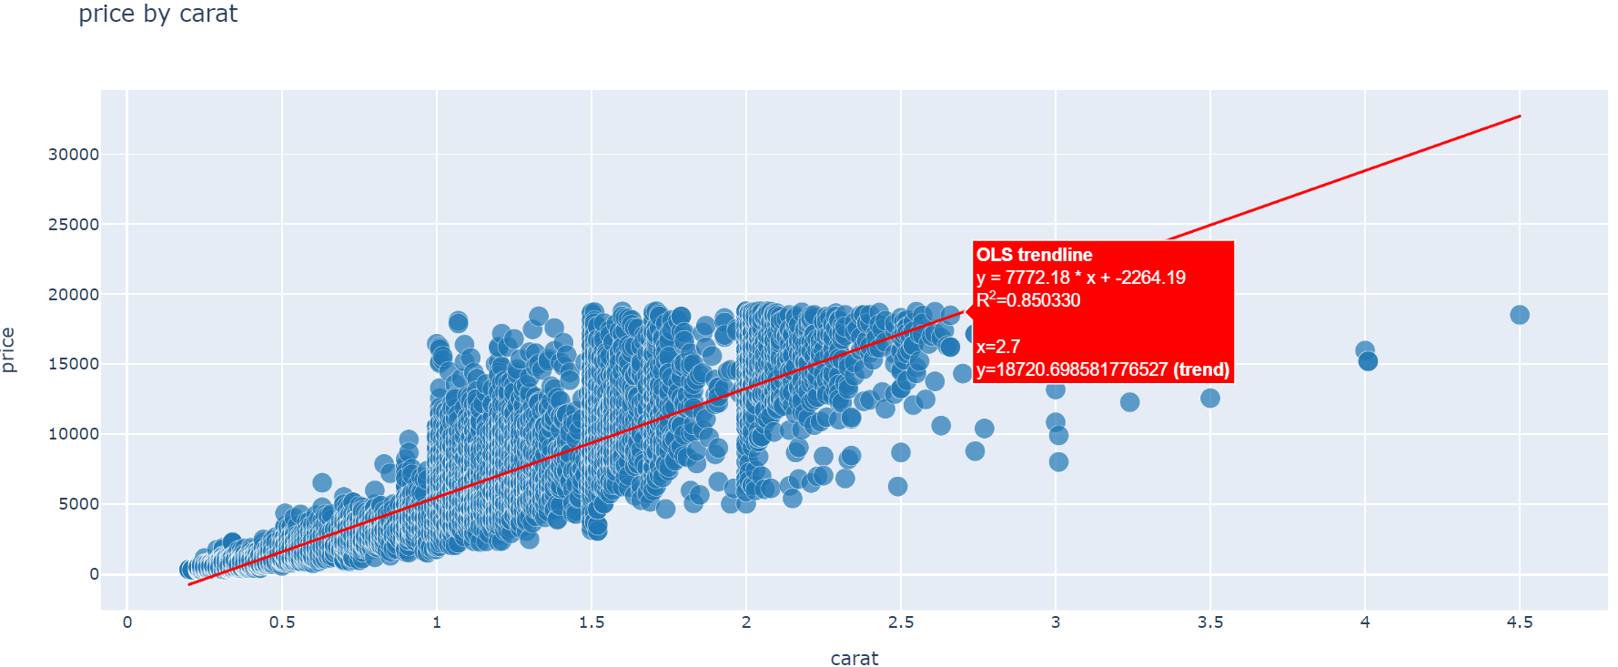
Correlation Analysis with Price -->As Carat of the cubic zirconia is highly correlated with price of it, Carat of the gem stone is an essential aspect while decision is made by customers with respect to dimension and price of the same. As from the univariate analysis its shows that there is lot manufacturing happening in the carat range of 0.4 to 1.05, to maximize the profit and income to the business: *company has to increase the carat value with more manufactured units*.

Slide 4
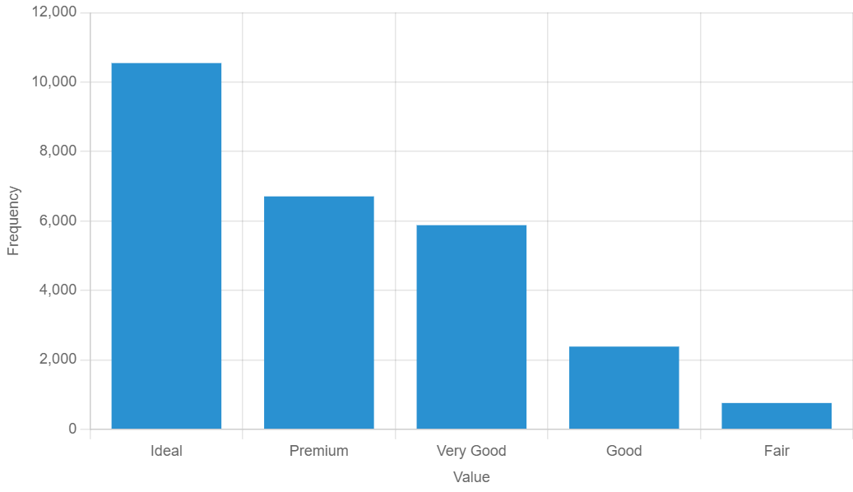
Analysis of Cut Characteristic The cut characteristics of cubic zirconia gemstones fall into 4 category and they are Ideal->10546, Premium->6707 ,Very Good->5878, Good->2382 ,Fair->757 From the above data its clear to interpret that most the cubic zirconia are manufactured by Ideal,Premium and Very Good cut.

Slide 5
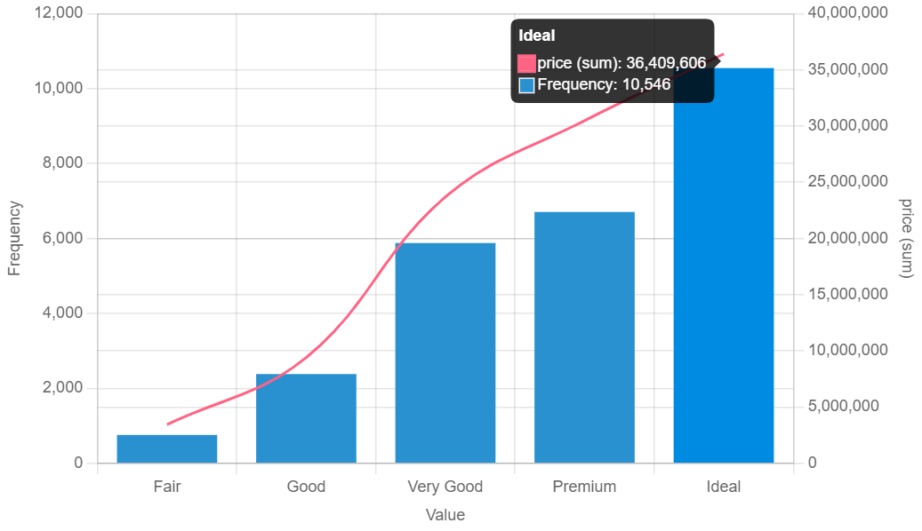
Correlation Analysis with Price The gem stones which are manufactured by Ideal cut has more price followed by Premium and Very Good cut To maximize the profit the company should manufacture more gem stones by Ideal, Premium and Very Good cut

Slide 6
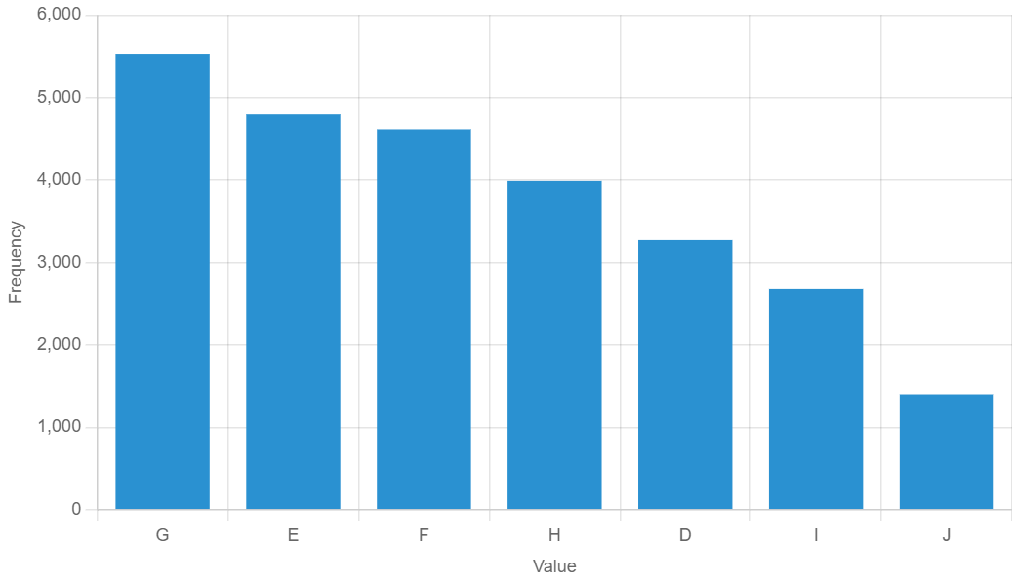
Analysis of Color characteristic The color of cubic zirconia is measured as per the Diamond color grading scale ranging from D to J corresponding to best to worst and the number of gemstones manufactured in different grading scale is as follows: D-3268, E-4793, F-4612, G-5529 ,H-3991, I-2676, J-1401 From the above data is clear to interpret that the number of manufactures in D color grade is 3268 which is very low as compared to E,F,G color grades which each has the number range of 4500 to 5000 approximately

Slide 7
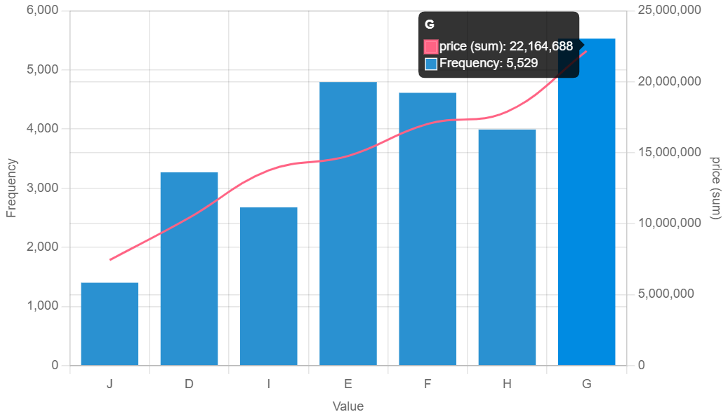
Correlation analysis with Price The price of G,F,E color grade has higher price sum and company should more produce the gem stones with G,F,E color grade to maximize their income

Slide 8
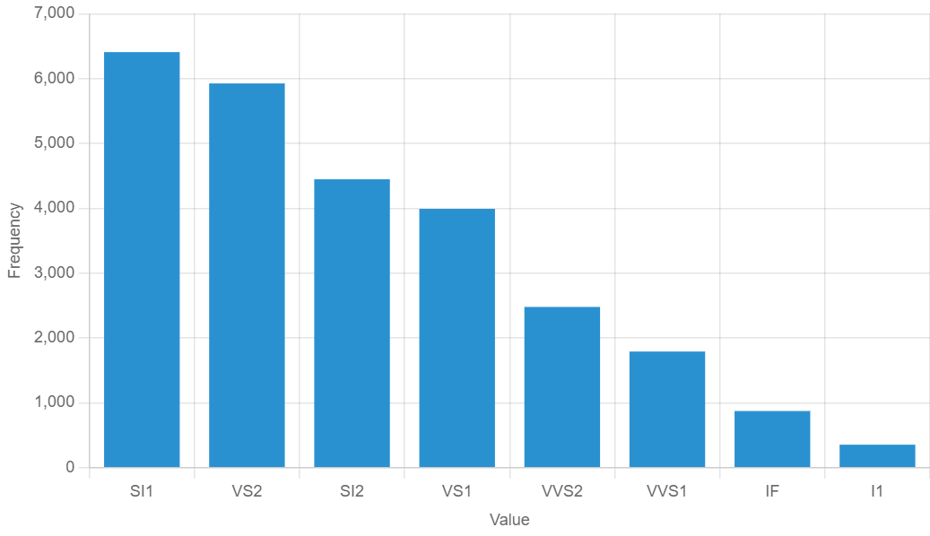
Analysis of Clarity characteristic The clarity grading of cubic zirconia is based on structural imperfections denoted as blemishes and inclusions and they are categorized into various groups based on inclusion: SI1 (6408), VS2 (5925) ,SI2 (4447), VS1 (3991), VVS2 (2479) ,VVS1 (1791), IF (874) , I1 (355)

Slide 9
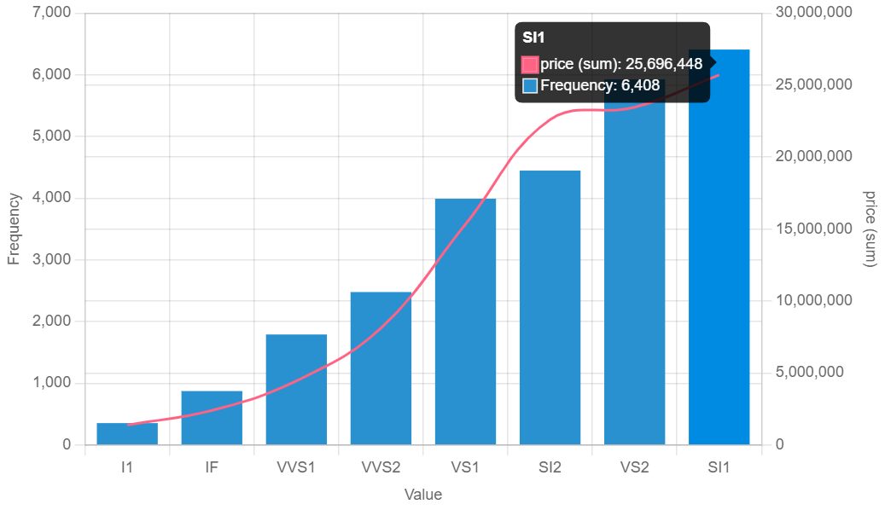
Correlation Analysis with Price The price sum is more for SI1,VS2 followed by SI2 and VS1 To maximize the income the company should also start manufacturing gem stones with VS1 clarity by maintaining the products of VS2 and SI1

Slide 10
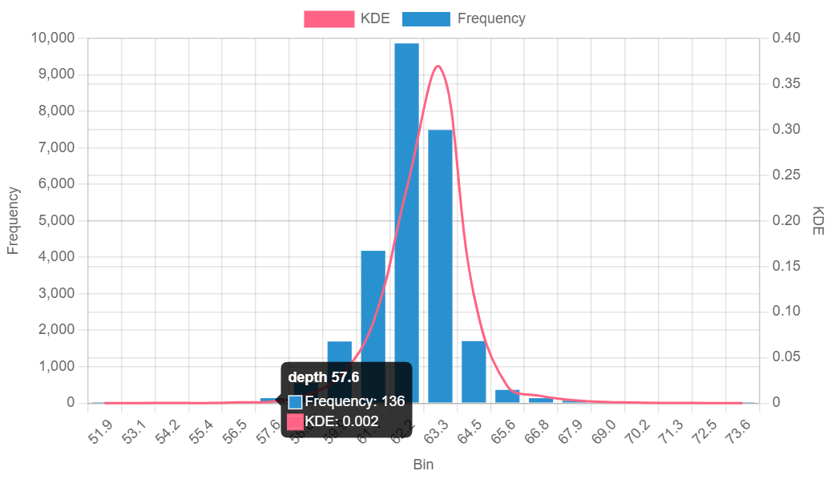
Analysis Of Depth Characteristic The depth of cubic zirconia ranges between 50 to 73 and interquartile range or middle 50 percent of the data points lies between 61 to 62.5

Slide 11
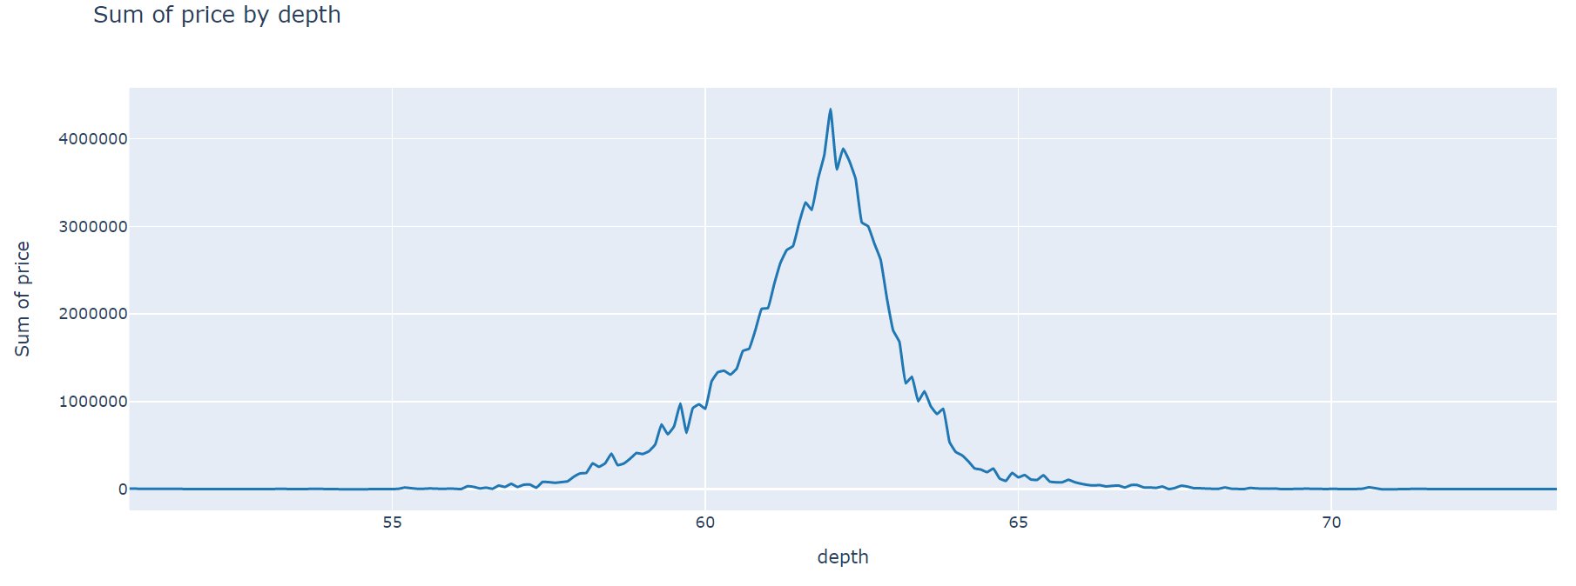
Correlation Analysis with Price Depth is slightly negatively correlated with price and as most were manufactured with higher value of depth with the frequency of 9000 on depth of 62 and 7000 on depth of 63, the company should find ways to make gem stones with less depth as possible to decrease the loss and move towards profit gain

Slide 12
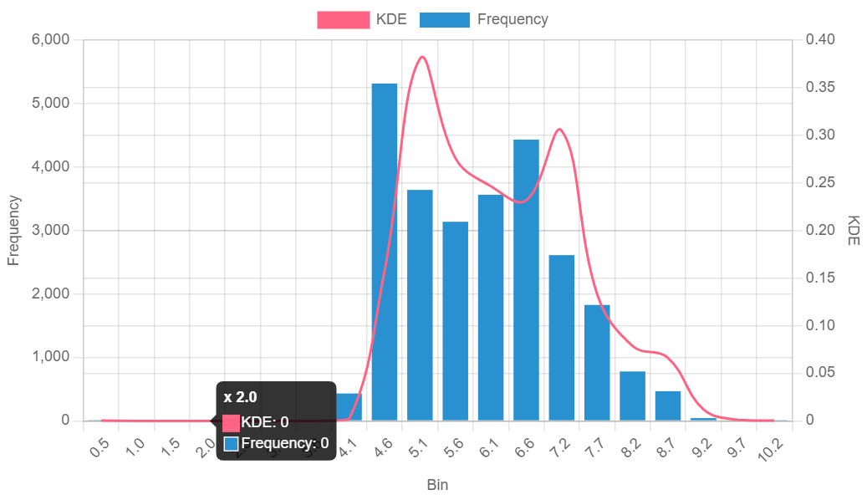
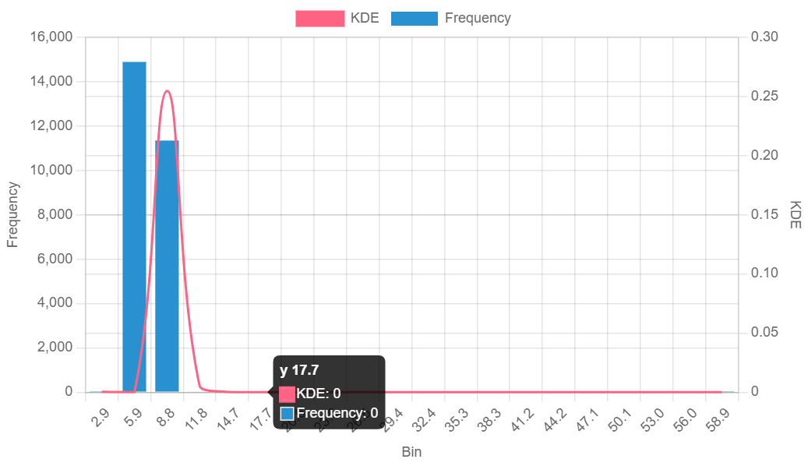
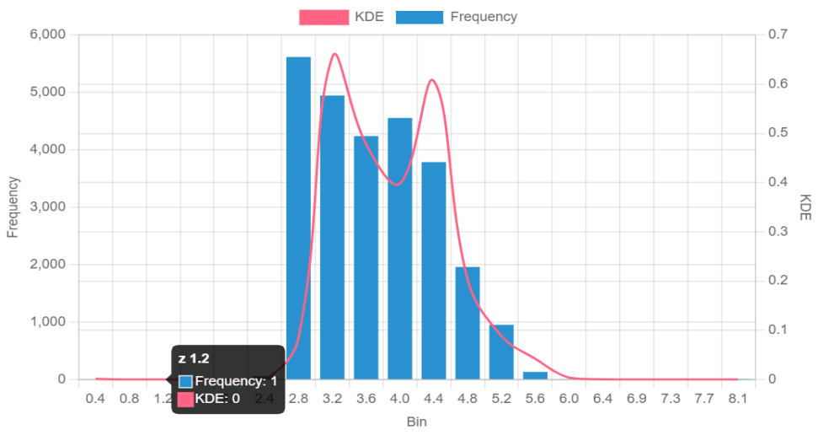
Analysis of Length, Width and Breadth Length(x): The length of cubic zirconia ranges between 0 to 10.23 and interquartile range or middle 50 percent of the data points lies between 4.7 to 6.55 Width(y): The widthof cubic zirconia ranges between 0 to 58.9 and interquartile range or middle 50 percent of the data points lies between 4.72 to 6.94 Height(z): The height of cubic zirconia ranges between 0 to 8 and interquartile range or middle 50 percent of the data points lies between 2.9 to 4.4

Slide 13
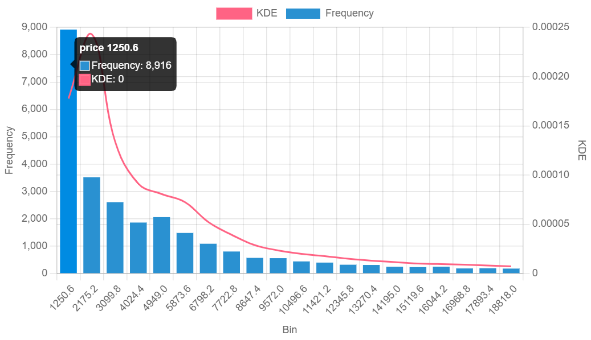
Analysis of Price The prices of cubic zirconia ranges between 326 to 18818 and the middle 50 percent of the gem stones have price range: 945 TO 5361 and as per the frequency distribution, the number of cubic zirconia and its prices are: 1250->8916, 2175->3500, 3000->2600 covering most of the manufactured stones and few have very high rates and their amount of manufacturing units are also small.

